Slide 1
USA Business Trip June 2012
Torbjörn and Michael at the Visitor Center and having Family” Dinner
Sierra Nevada Brewing Co.
Chico
by
Finn Knudsen

Slide 2
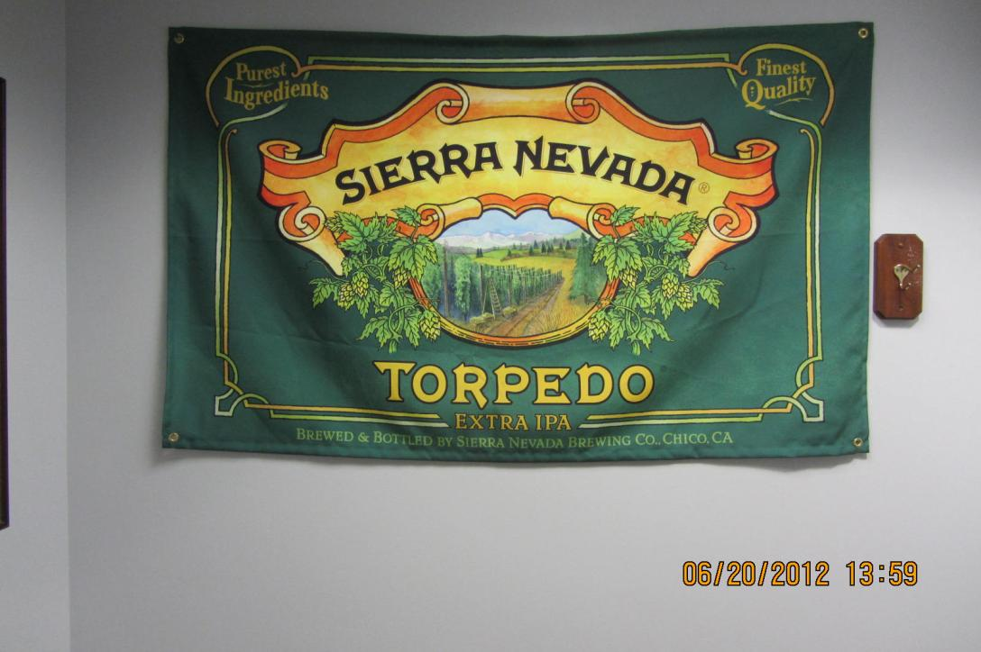
2012-06-20 - At the visitor center and Big Room - Sierra Nevada Brewing Co - Michael og Torbjörn (3)

Slide 3
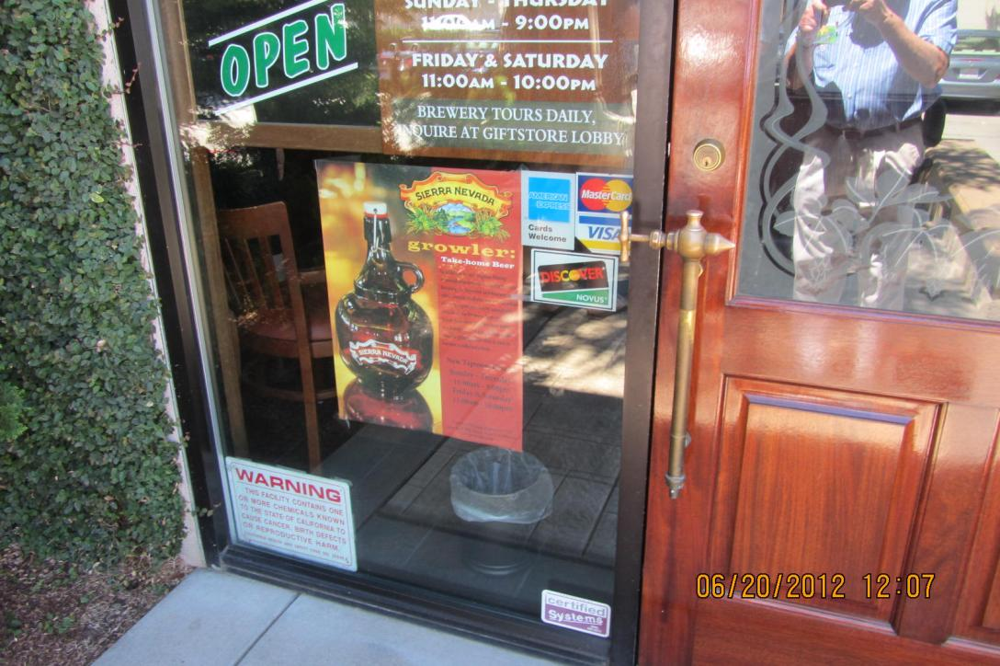
2012-06-20 - At the visitor center and Big Room - Sierra Nevada Brewing Co - Michael og Torbjörn

Slide 4
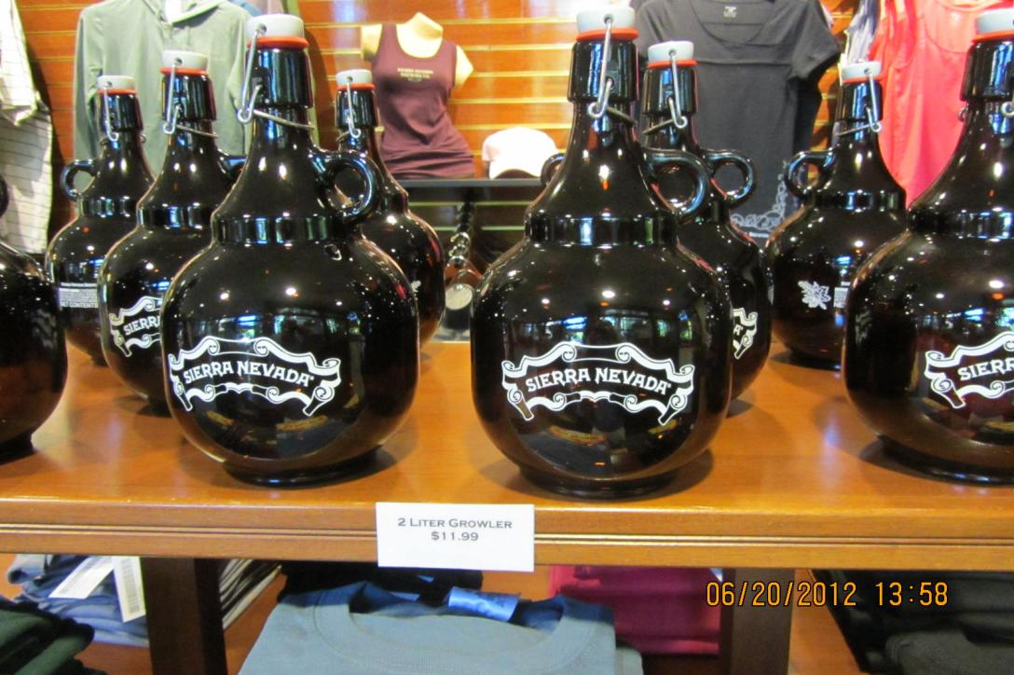
2012-06-20 - At the visitor center and Big Room - Sierra Nevada Brewing Co - Michael og Torbjörn (1)

Slide 5
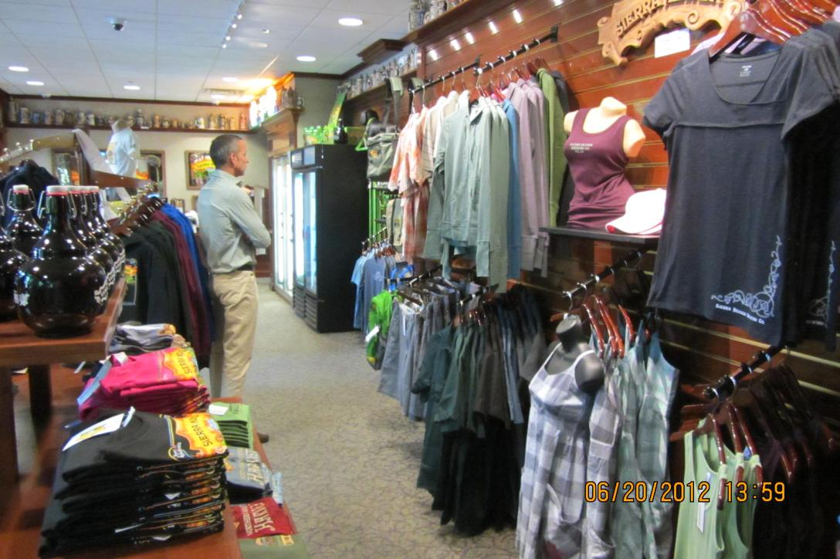
2012-06-20 - At the visitor center and Big Room - Sierra Nevada Brewing Co - Michael og Torbjörn (2)

Slide 6
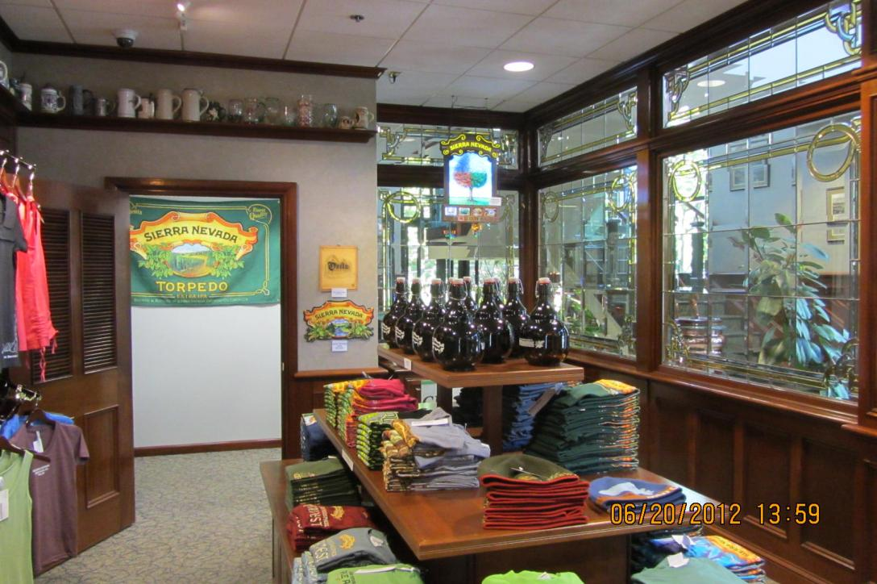
2012-06-20 - At the visitor center and Big Room - Sierra Nevada Brewing Co - Michael og Torbjörn (4)

Slide 7
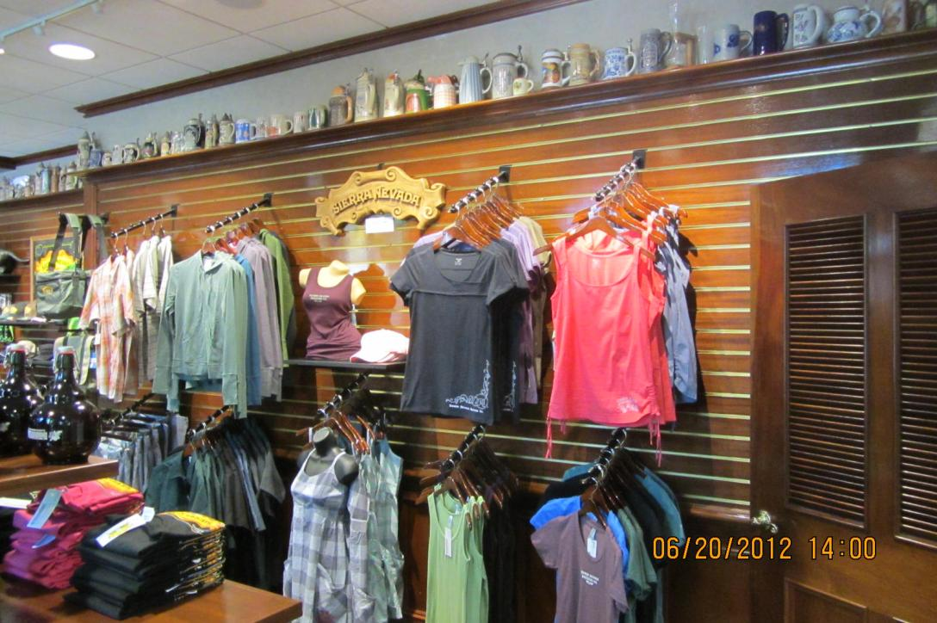
2012-06-20 - At the visitor center and Big Room - Sierra Nevada Brewing Co - Michael og Torbjörn (5)

Slide 8
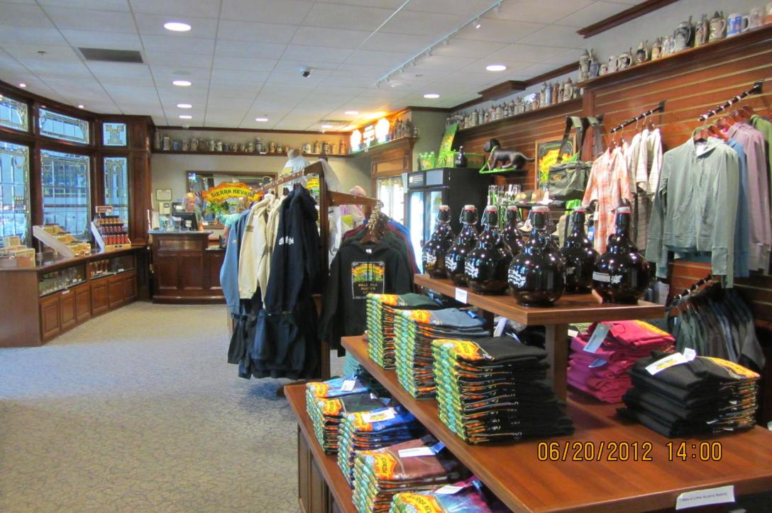
2012-06-20 - At the visitor center and Big Room - Sierra Nevada Brewing Co - Michael og Torbjörn (6)

Slide 9
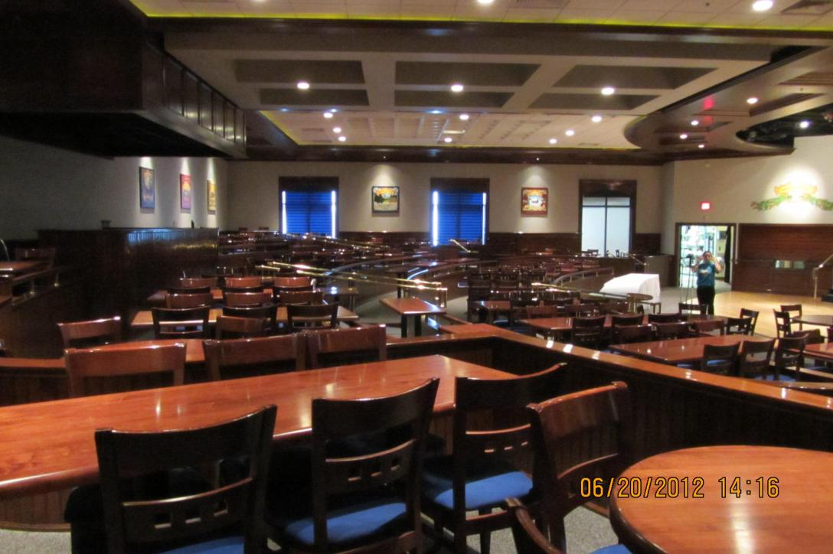
2012-06-20 - At the visitor center and Big Room - Sierra Nevada Brewing Co - Michael og Torbjörn (7)

Slide 10
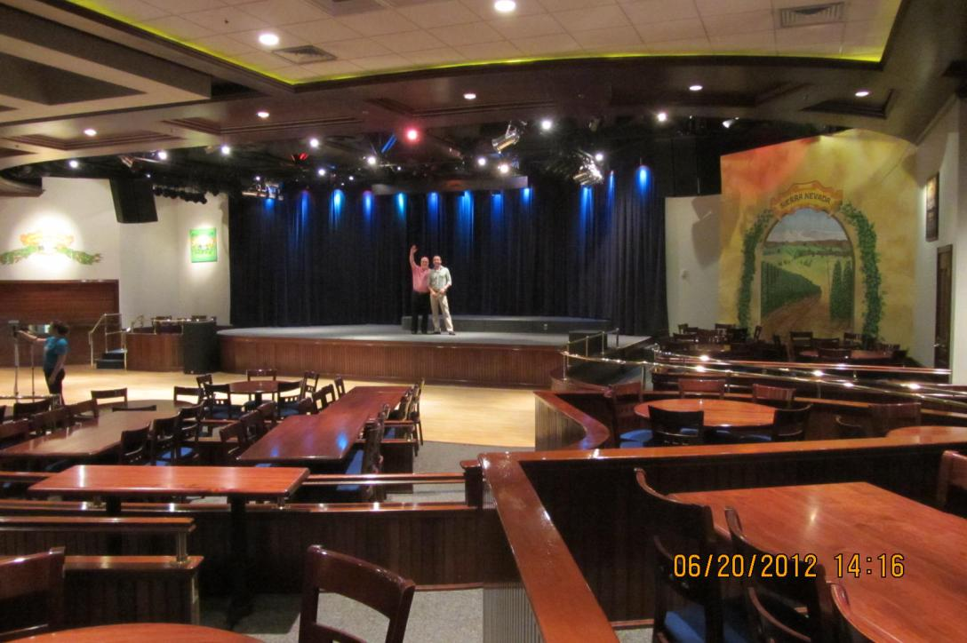
2012-06-20 - At the visitor center and Big Room - Sierra Nevada Brewing Co - Michael og Torbjörn (8)

Slide 11
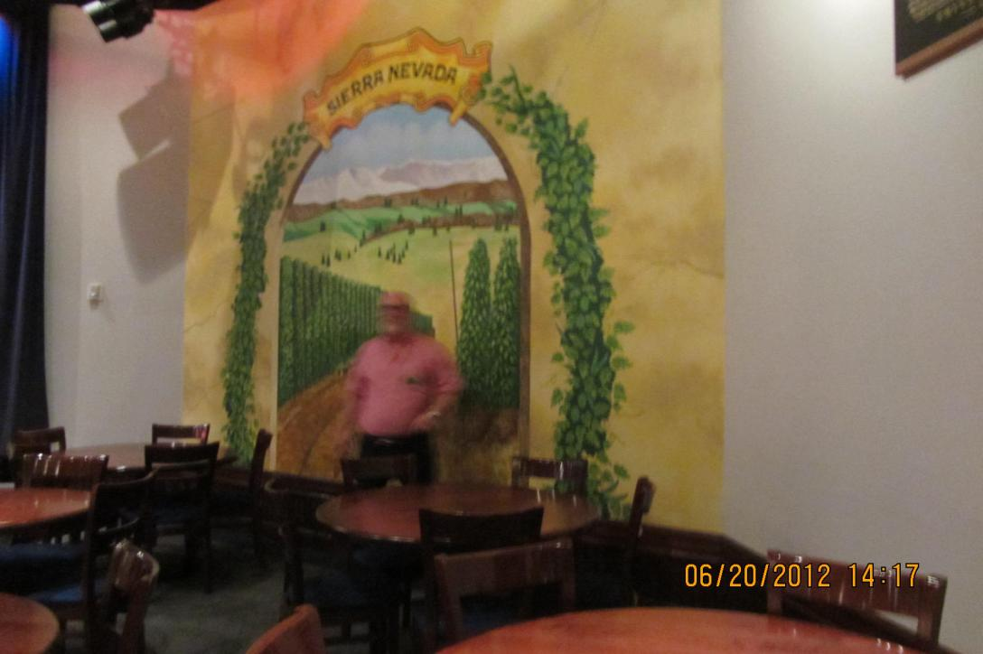
2012-06-20 - At the visitor center and Big Room - Sierra Nevada Brewing Co - Michael og Torbjörn (9)

Slide 12
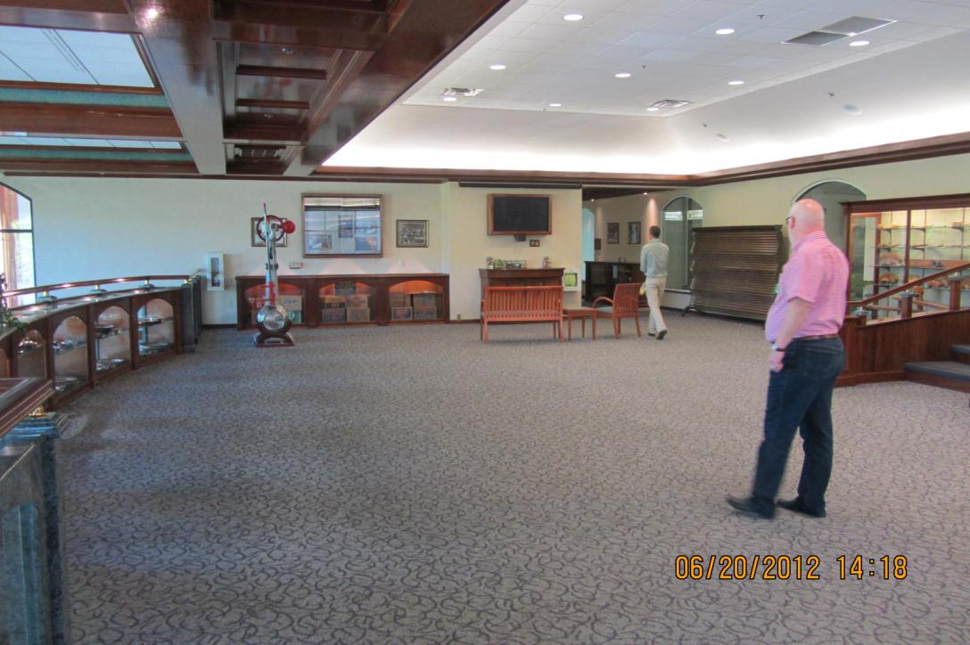
2012-06-20 - At the visitor center and Big Room - Sierra Nevada Brewing Co - Michael og Torbjörn (10)

Slide 13
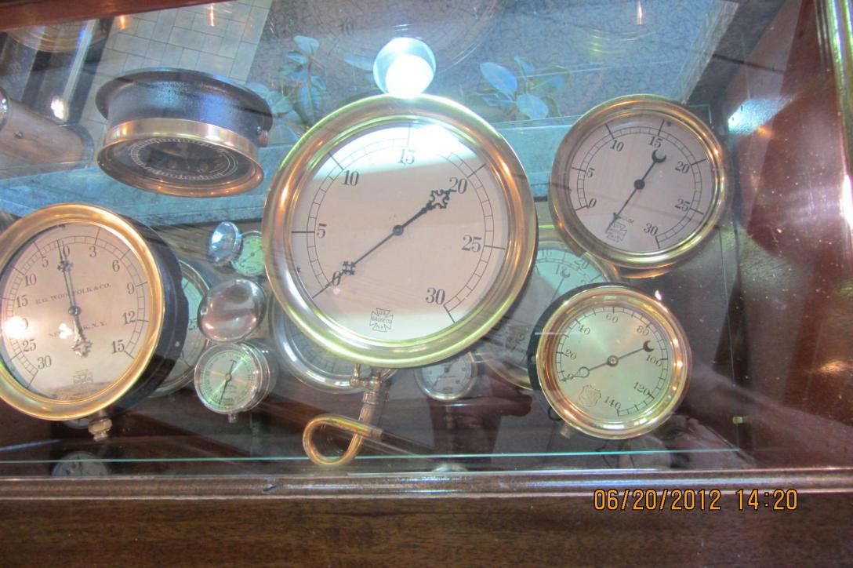
2012-06-20 - At the visitor center and Big Room - Sierra Nevada Brewing Co - Michael og Torbjörn (11)

Slide 14
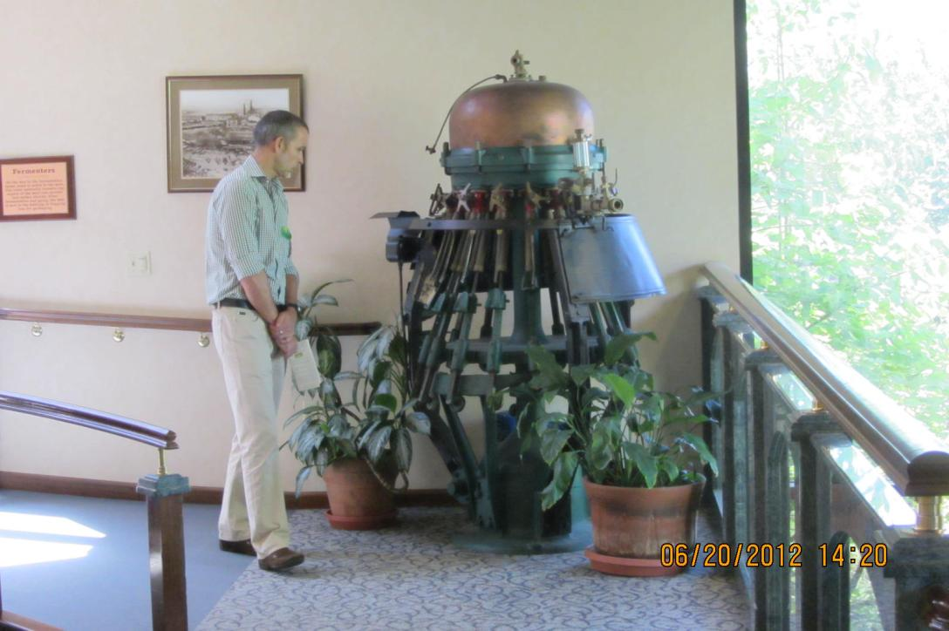
2012-06-20 - At the visitor center and Big Room - Sierra Nevada Brewing Co - Michael og Torbjörn (12)

Slide 15
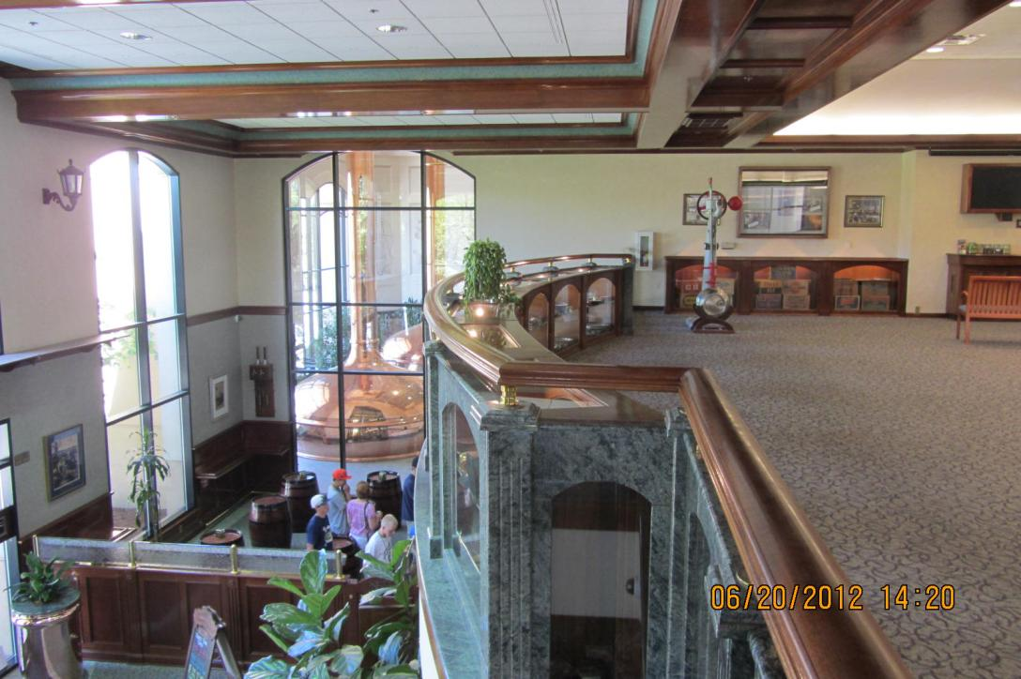
2012-06-20 - At the visitor center and Big Room - Sierra Nevada Brewing Co - Michael og Torbjörn (13)

Slide 16
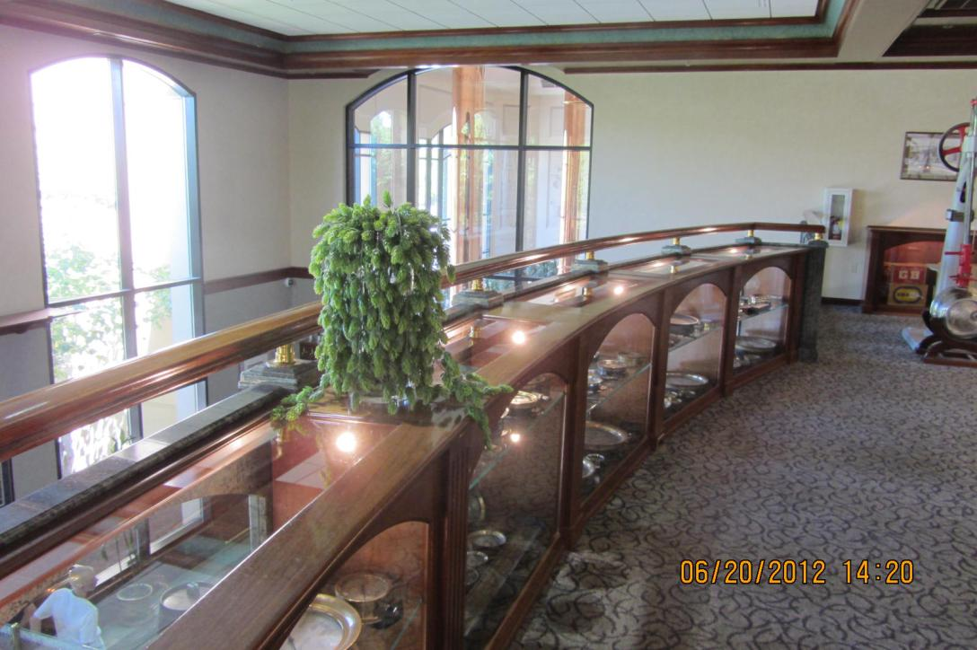
2012-06-20 - At the visitor center and Big Room - Sierra Nevada Brewing Co - Michael og Torbjörn (14)

Slide 17
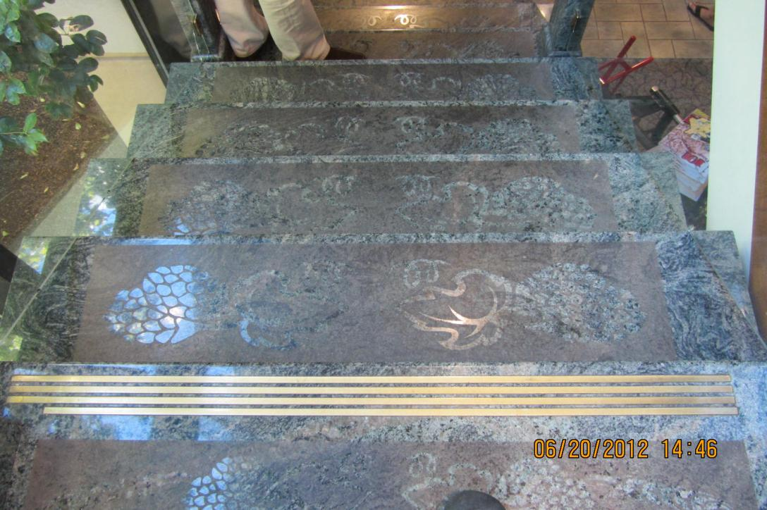
2012-06-20 - At the visitor center and Big Room - Sierra Nevada Brewing Co - Michael og Torbjörn (15)

Slide 18
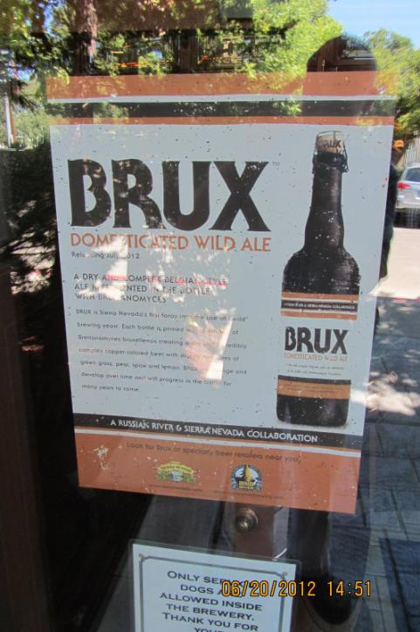
2012-06-20 - At the visitor center and Big Room - Sierra Nevada Brewing Co - Michael og Torbjörn (16)

Slide 19
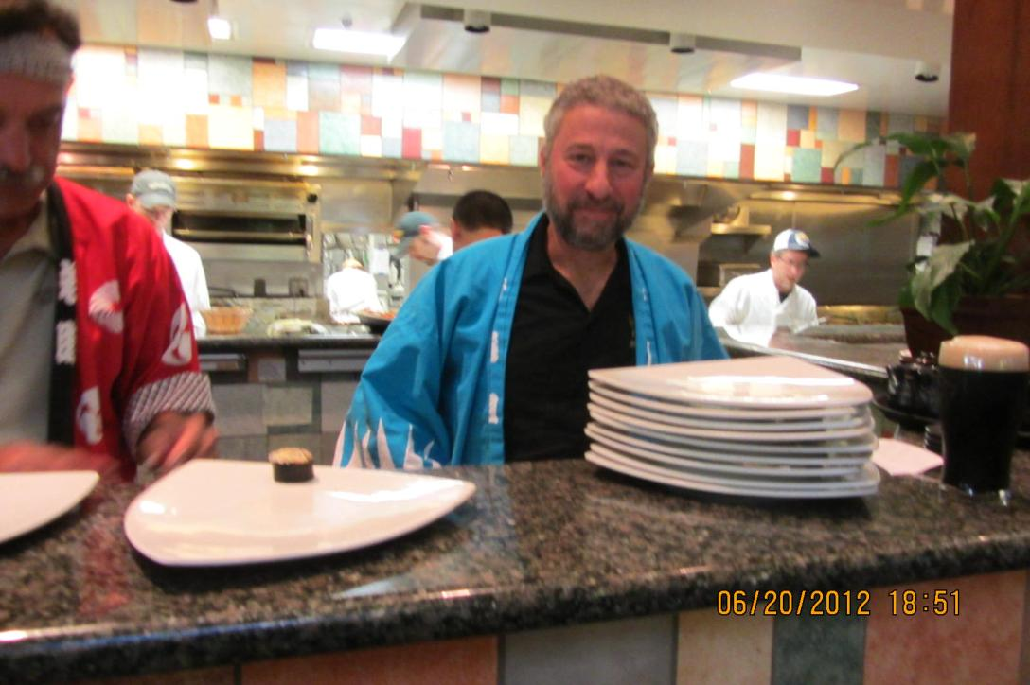
2012-06-20 - Dinner at Sierra Nevada Brewing Co - Sushi night with chef Ken

Slide 20
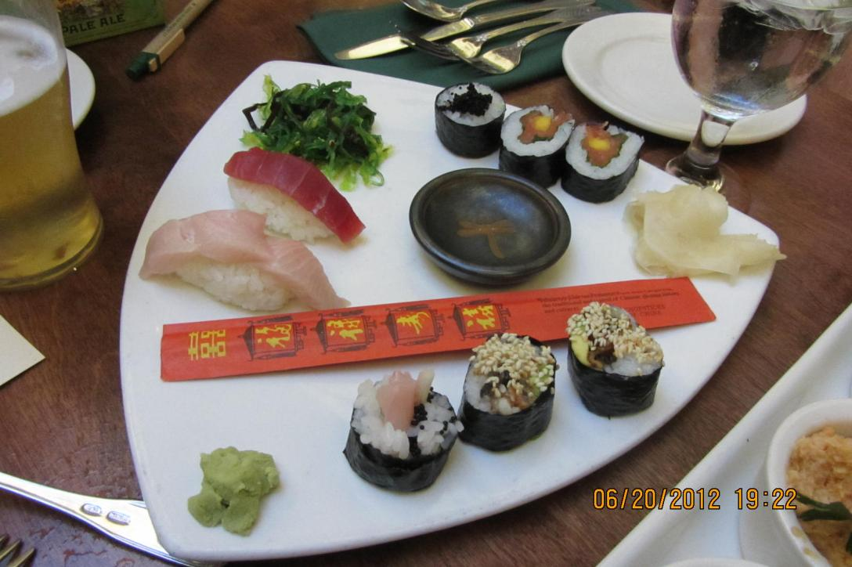
2012-06-20 - Dinner at Sierra Nevada Brewing Co - Sushi night (8)

Slide 21
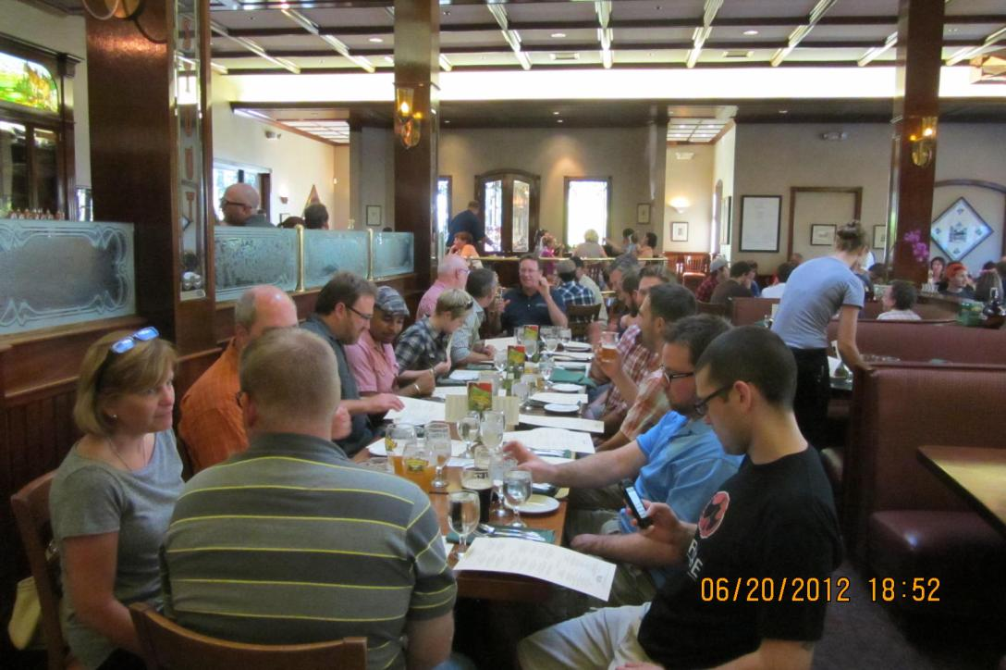
2012-06-20 - Dinner at Sierra Nevada Brewing Co - Sushi night

Slide 22
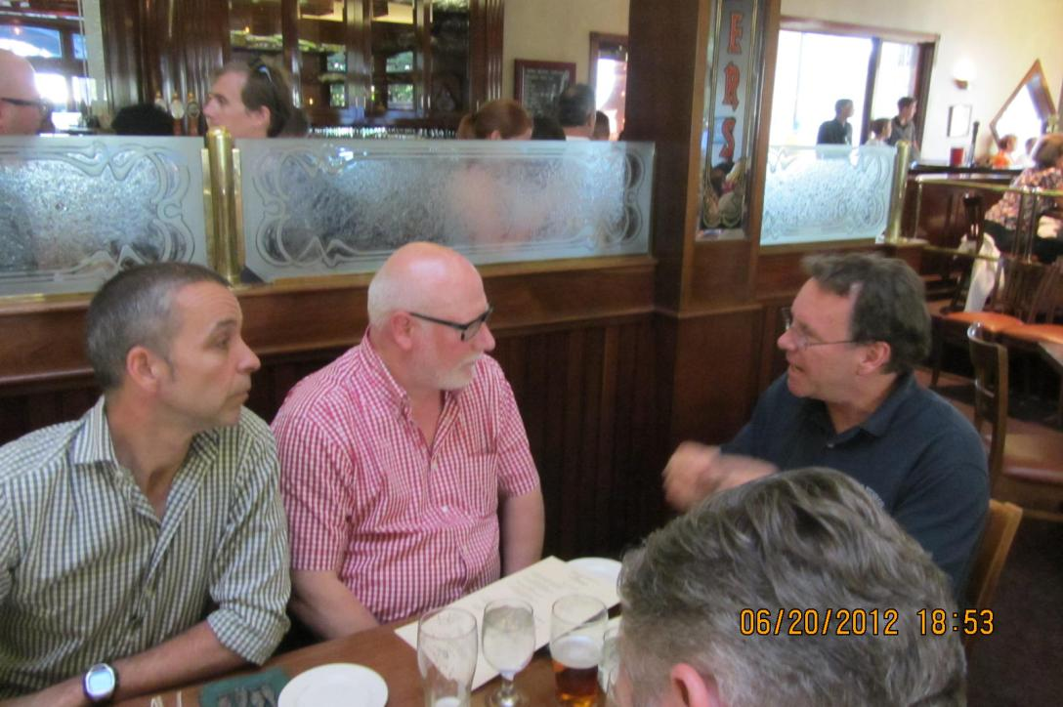
2012-06-20 - Dinner at Sierra Nevada Brewing Co - Sushi night (1)

Slide 23
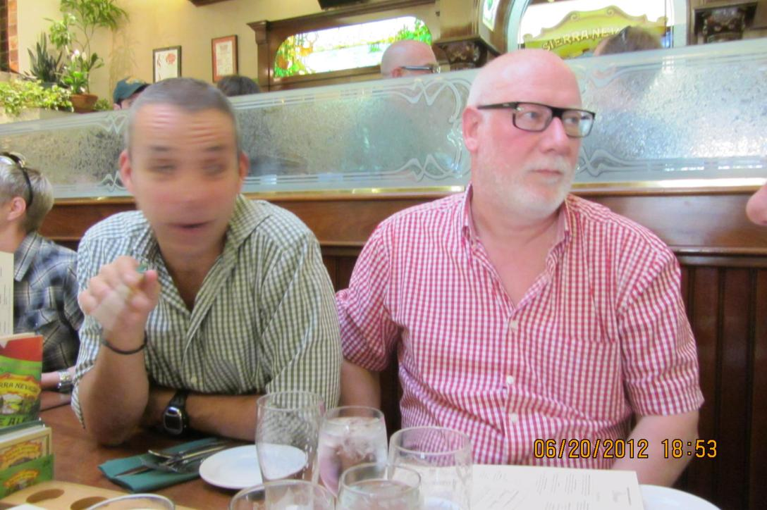
2012-06-20 - Dinner at Sierra Nevada Brewing Co - Sushi night (2)

Slide 24
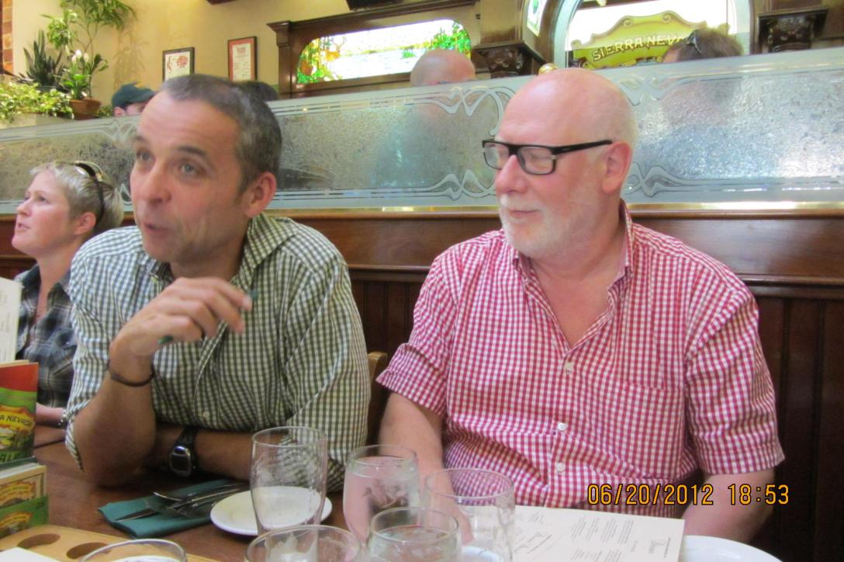
2012-06-20 - Dinner at Sierra Nevada Brewing Co - Sushi night (3)

Slide 25
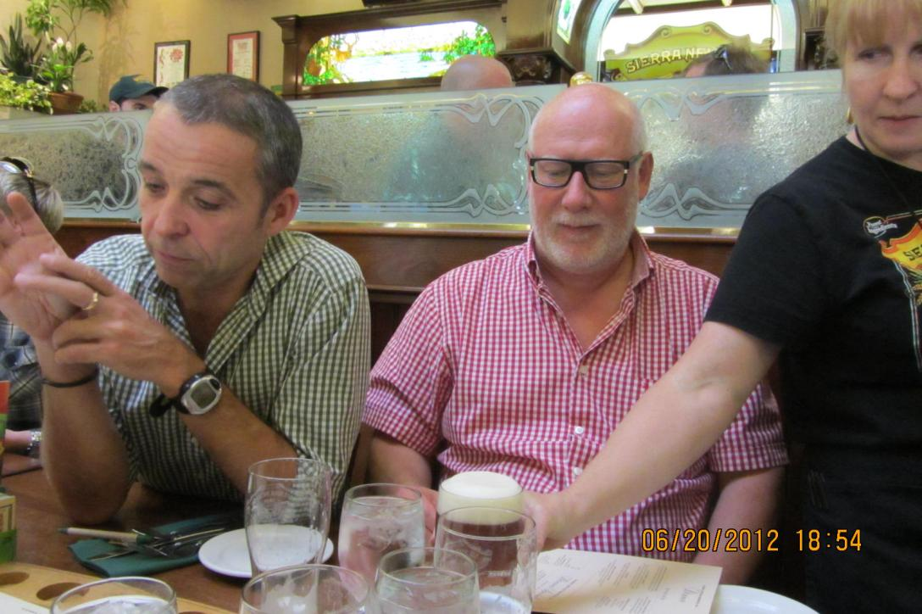
2012-06-20 - Dinner at Sierra Nevada Brewing Co - Sushi night (4)

Slide 26
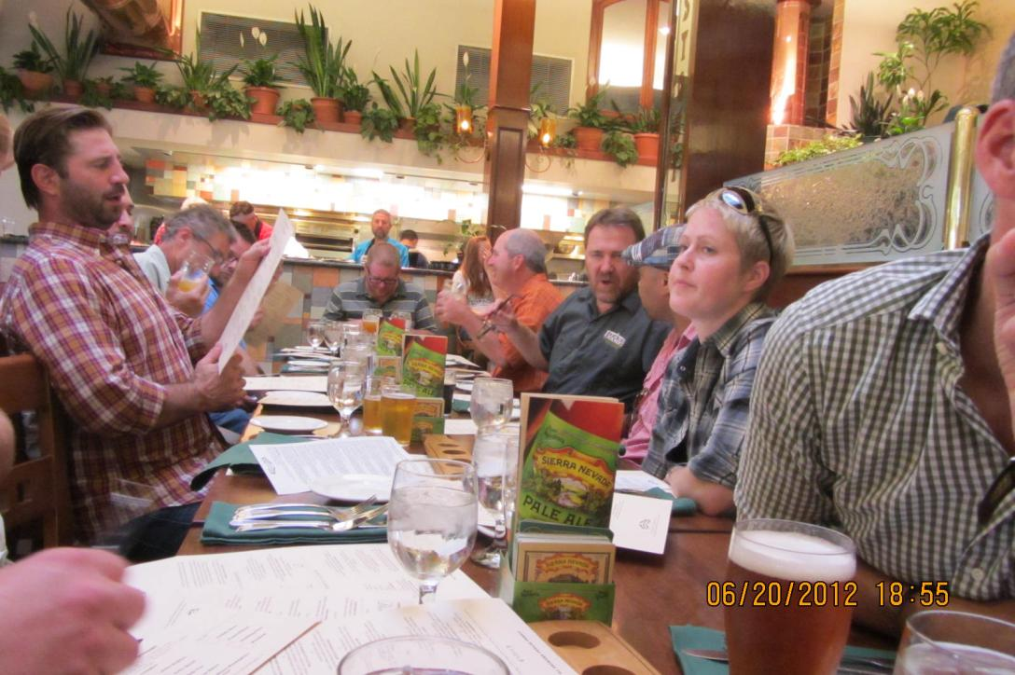
2012-06-20 - Dinner at Sierra Nevada Brewing Co - Sushi night (5)

Slide 27
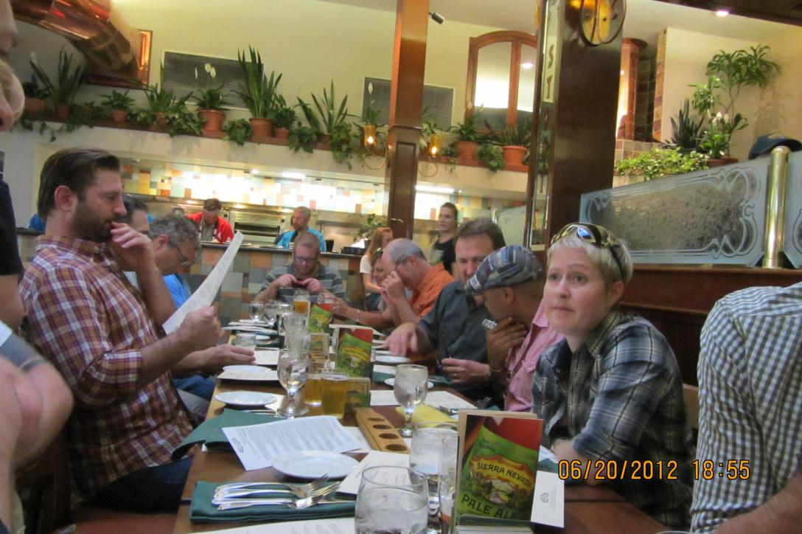
2012-06-20 - Dinner at Sierra Nevada Brewing Co - Sushi night (6)

Slide 28
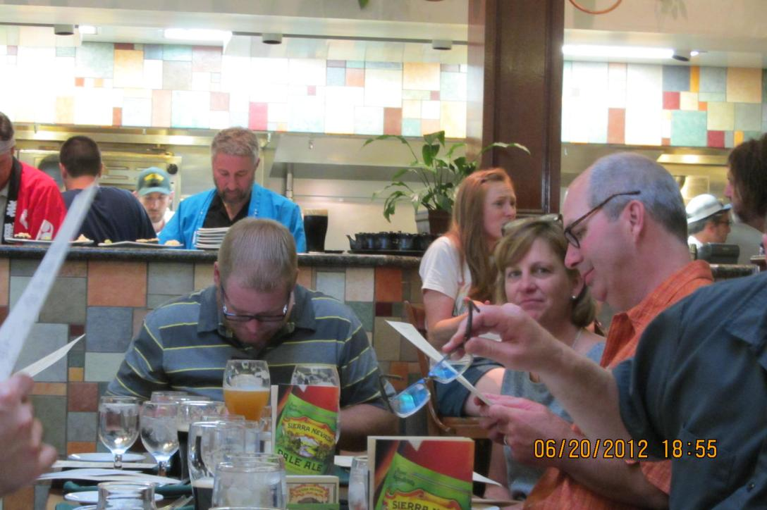
2012-06-20 - Dinner at Sierra Nevada Brewing Co - Sushi night (7)

Slide 29
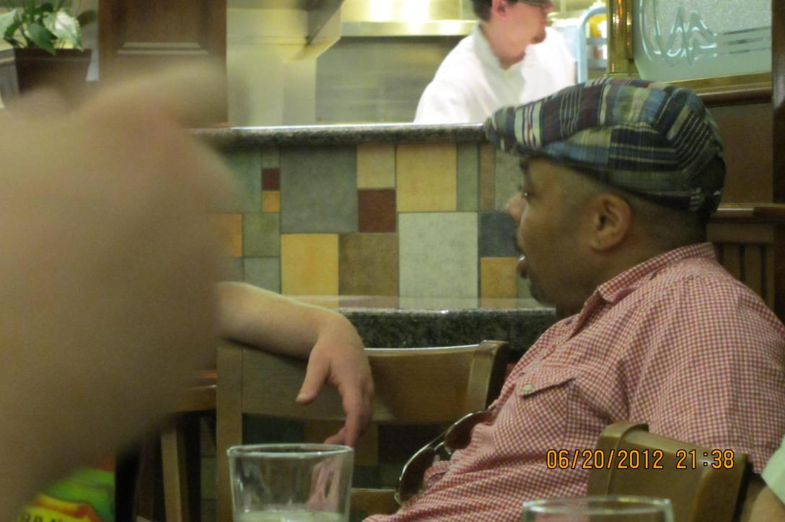
2012-06-20 - Dinner at Sierra Nevada Brewing Co - Sushi night (11)

Slide 30
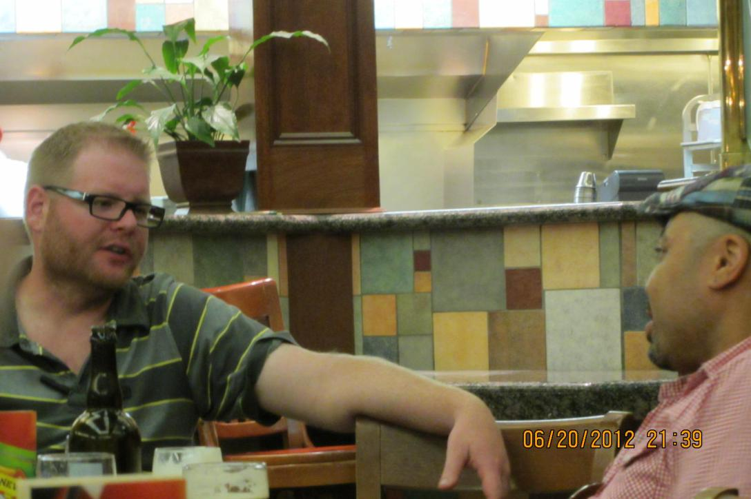
2012-06-20 - Dinner at Sierra Nevada Brewing Co - Sushi night (12)

Slide 31
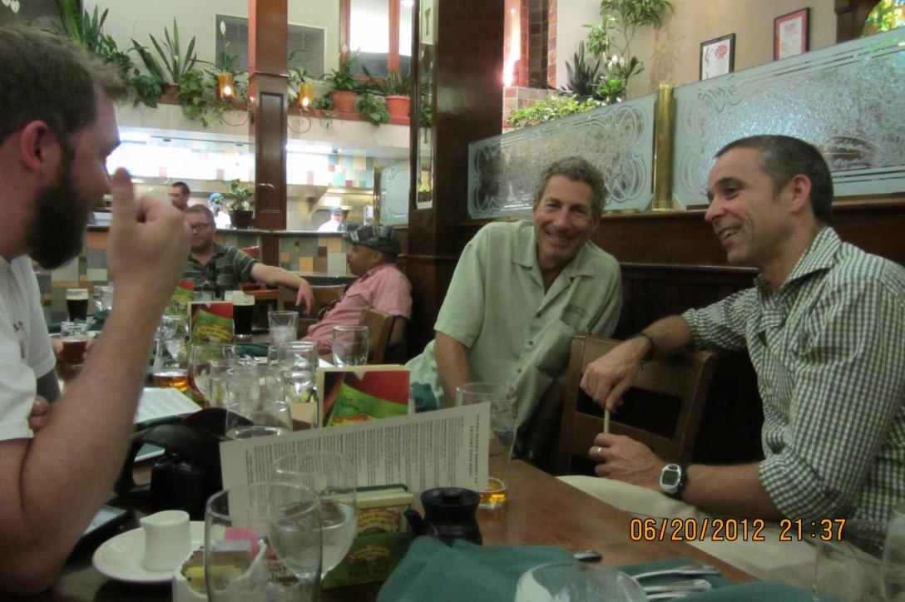
2012-06-20 - Dinner at Sierra Nevada Brewing Co - Sushi night (10)

Slide 32
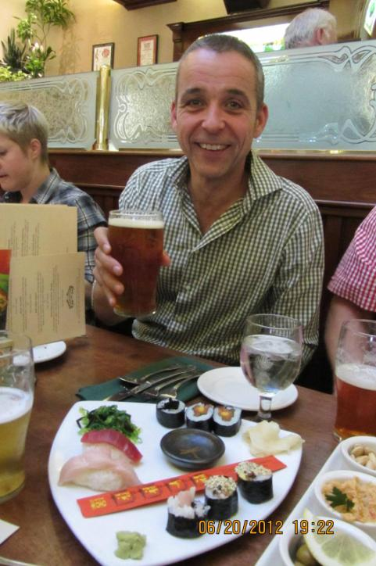
2012-06-20 - Dinner at Sierra Nevada Brewing Co - Sushi night (9)

